Slide 1

KC Crime Predictive Analysis
Feel free to engage with the outputs at https://sarah-martin.github.io/KC_Crime_Predictive_Analysis/

Slide 2
Ideation
Our idea came from our Project 2 data dealing with crime in Kansas City, MO
We wanted to predict what total crime would look like in the upcoming years
Also wanted to look at what would happen specifically with the number of homicides

Slide 3
Tools
HTML / CSS / Bootstrap
Pandas
Matplotlib
Tableau for visualizations
Scikit-Learn

Slide 4
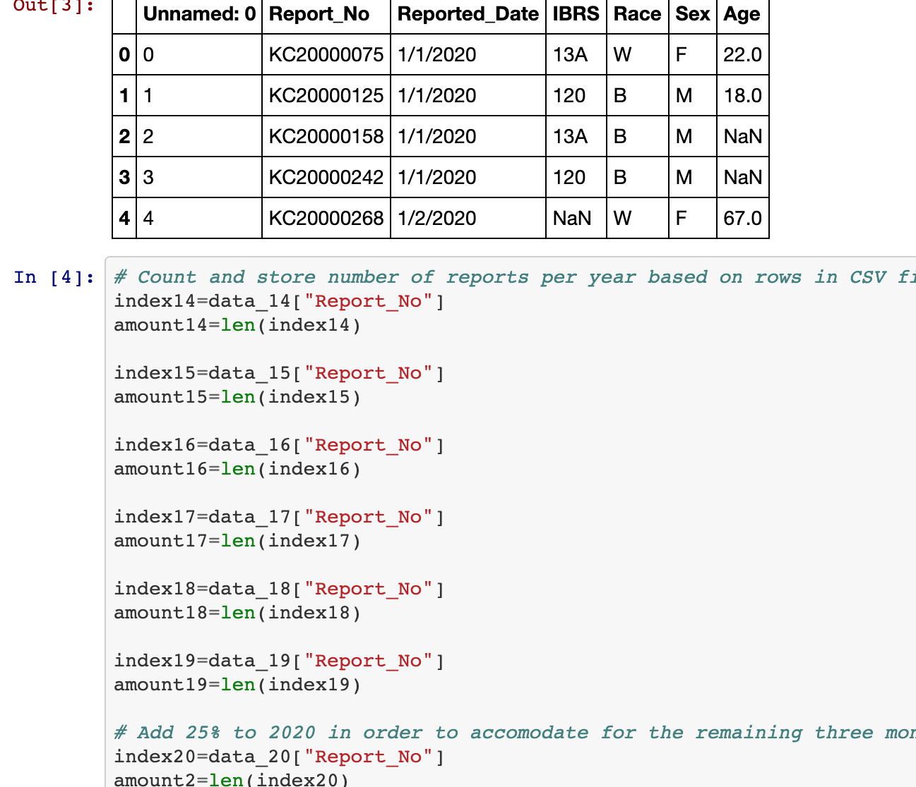
Data Cleaning Process
Imported and read CSV files from our source
Cleaned the data by specifying columns
Combined all years into one dataframe
We counted and stored the amount of reports per year for each CSV
Notes:
Also maybe mention: had to ensure variables were an integer, but basically wanted to keep all recorded reports, whether correctly input, so that we had an accurate depiction of the number of reported crimes that year.

Slide 5
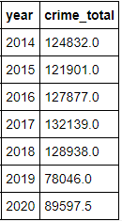
Data Cleaning Process
Stored all the amounts into a single list
Accounted for missing quarter year (multiplied the original number by 1.25)

Slide 6

Machine Learning

Slide 7
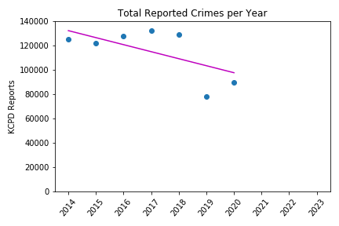
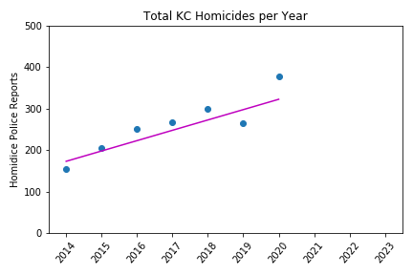
Model 1: Linear Regression
MSE: 58,466,128 R2: 0.84
MSE: 1869 R2: 0.53

Slide 8
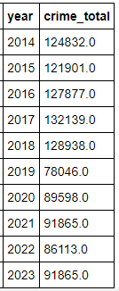
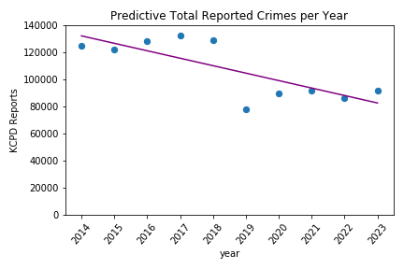
Model 1: Linear Predictions - Total Crime
Linear - Crime

Slide 9
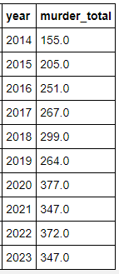
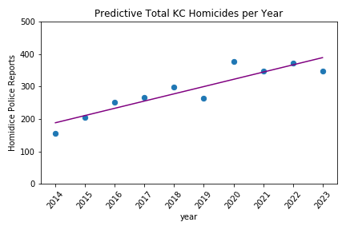
Model 1: Linear Predictions - Total Crime
Linear - Homicides

Slide 10
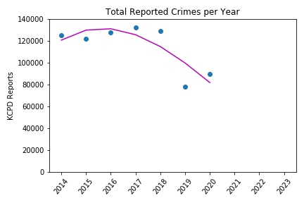
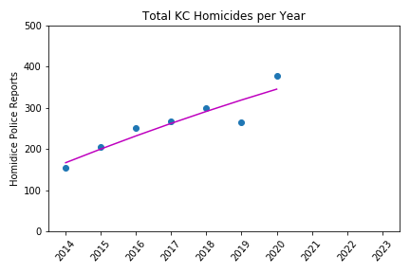
Model 2: Polynomial Regression
Degree: 3 RMSE: 11116 R2: 0.69
Degree: 3 RMSE: 25.75 R2: 0.84

Slide 11
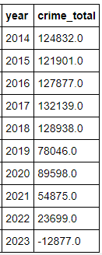
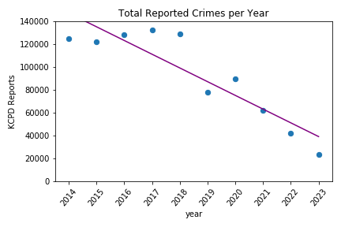
Model 1: Polynomial Predictions - Total Crime
Poly - Crime

Slide 12
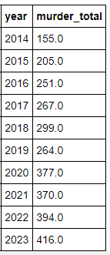
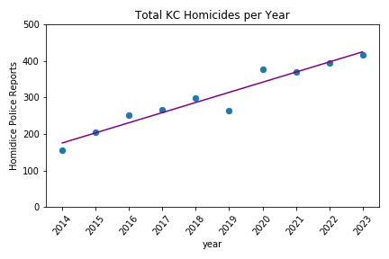
Model 1: Polynomial Predictions - Total Crime
Poly - Homicides

Slide 13
Tableau Analysis

Slide 14
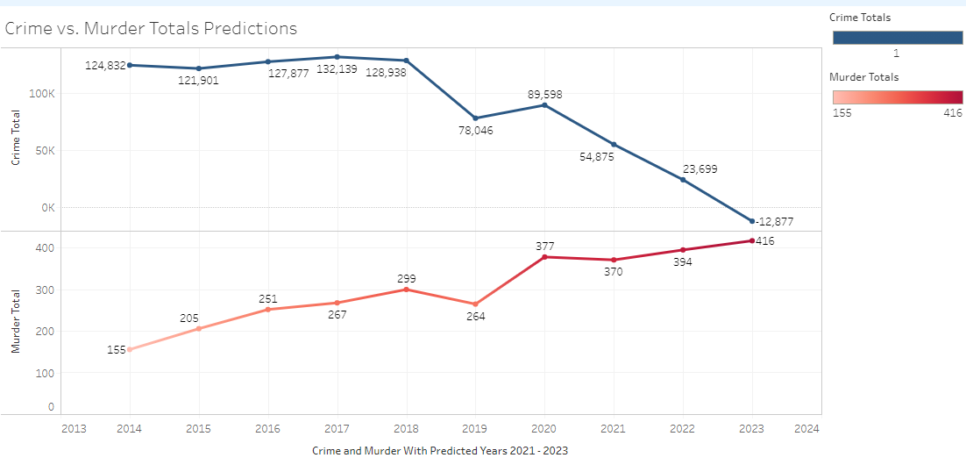
Tableau Integration
Tableau is a fantastic tool and visual aid for viewing data comparisons created from CSV files. In this chart we engineered the 2021 - 2023 based on the prior 7 years of overall crime and homicides.
Surprisingly enough the crime shows a decline but homicides reflect a slight increase.

Slide 15
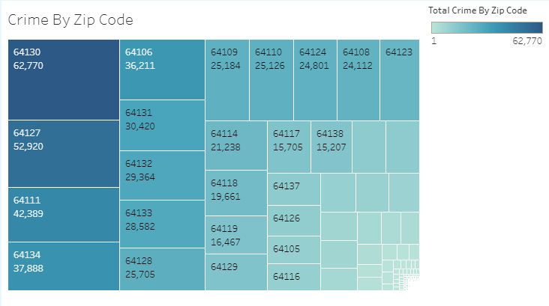
Crime By Zip Code
The zip code comparison is the total number of crime for all years broken down by zip code reflecting the highest areas of overall crime and flows down to the right to the least crime occurrences.

Slide 16
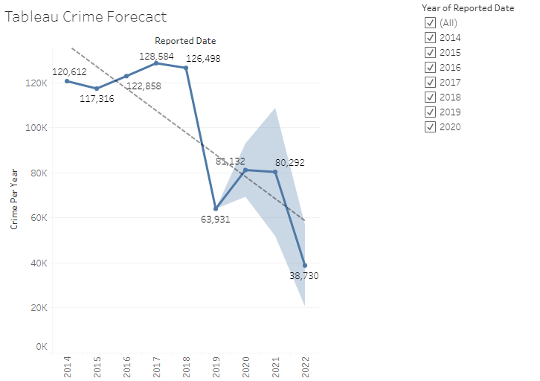
Crime Forecast
Using Tableau for “Forecasting” was fun in this slide. In this if you unselect all years, then start selecting from oldest to newest you will see it forcast out two years from the date you select. Then once you select the following year it adjust and give you the next two year forecast. This helps as you can see what the forecast is then what the true figures state as you move forward in time.

Slide 17
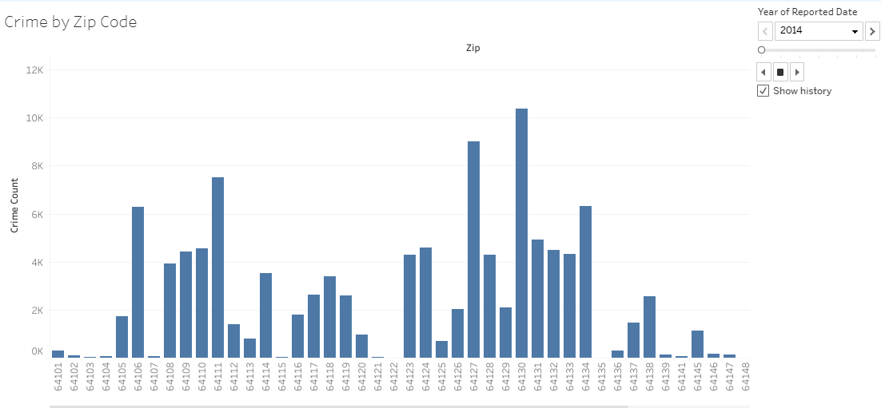
Crime by Zip Code
This bar chart is a depiction of general analysis for years 2014 - 2020 by zip code. This allows you to move through the years and select different time periods. This bar chart was created in Tableau and helps with the flow of year progression as changes are made through time.

Slide 18
Obstacles and Room for Improvement
The data does not go back far enough for a truly accurate picture.
It is unknown why the homicide data is so much higher than publically reported numbers (Cover-up??).
We could use this data to predict daily crime rates in future years, which could be used for police staffing.

Slide 19
Outcomes and Analysis
The linear regression provided the most stable and reasonable prediction.
Homicides in Kansas City continue to rise annually, and will continue to do so without intervention.
Total number of reported crimes have decreased the past few years, with a potential for gradual inclining again.

Slide 20
Questions?

